Slide 1
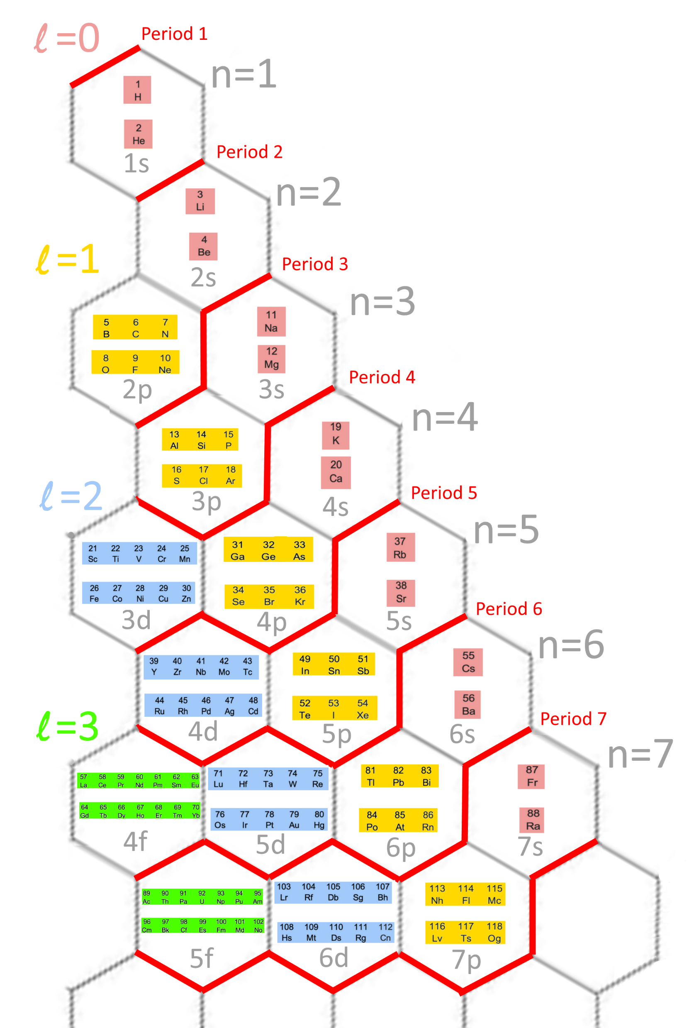
HexaFrame periodic table

Slide 2
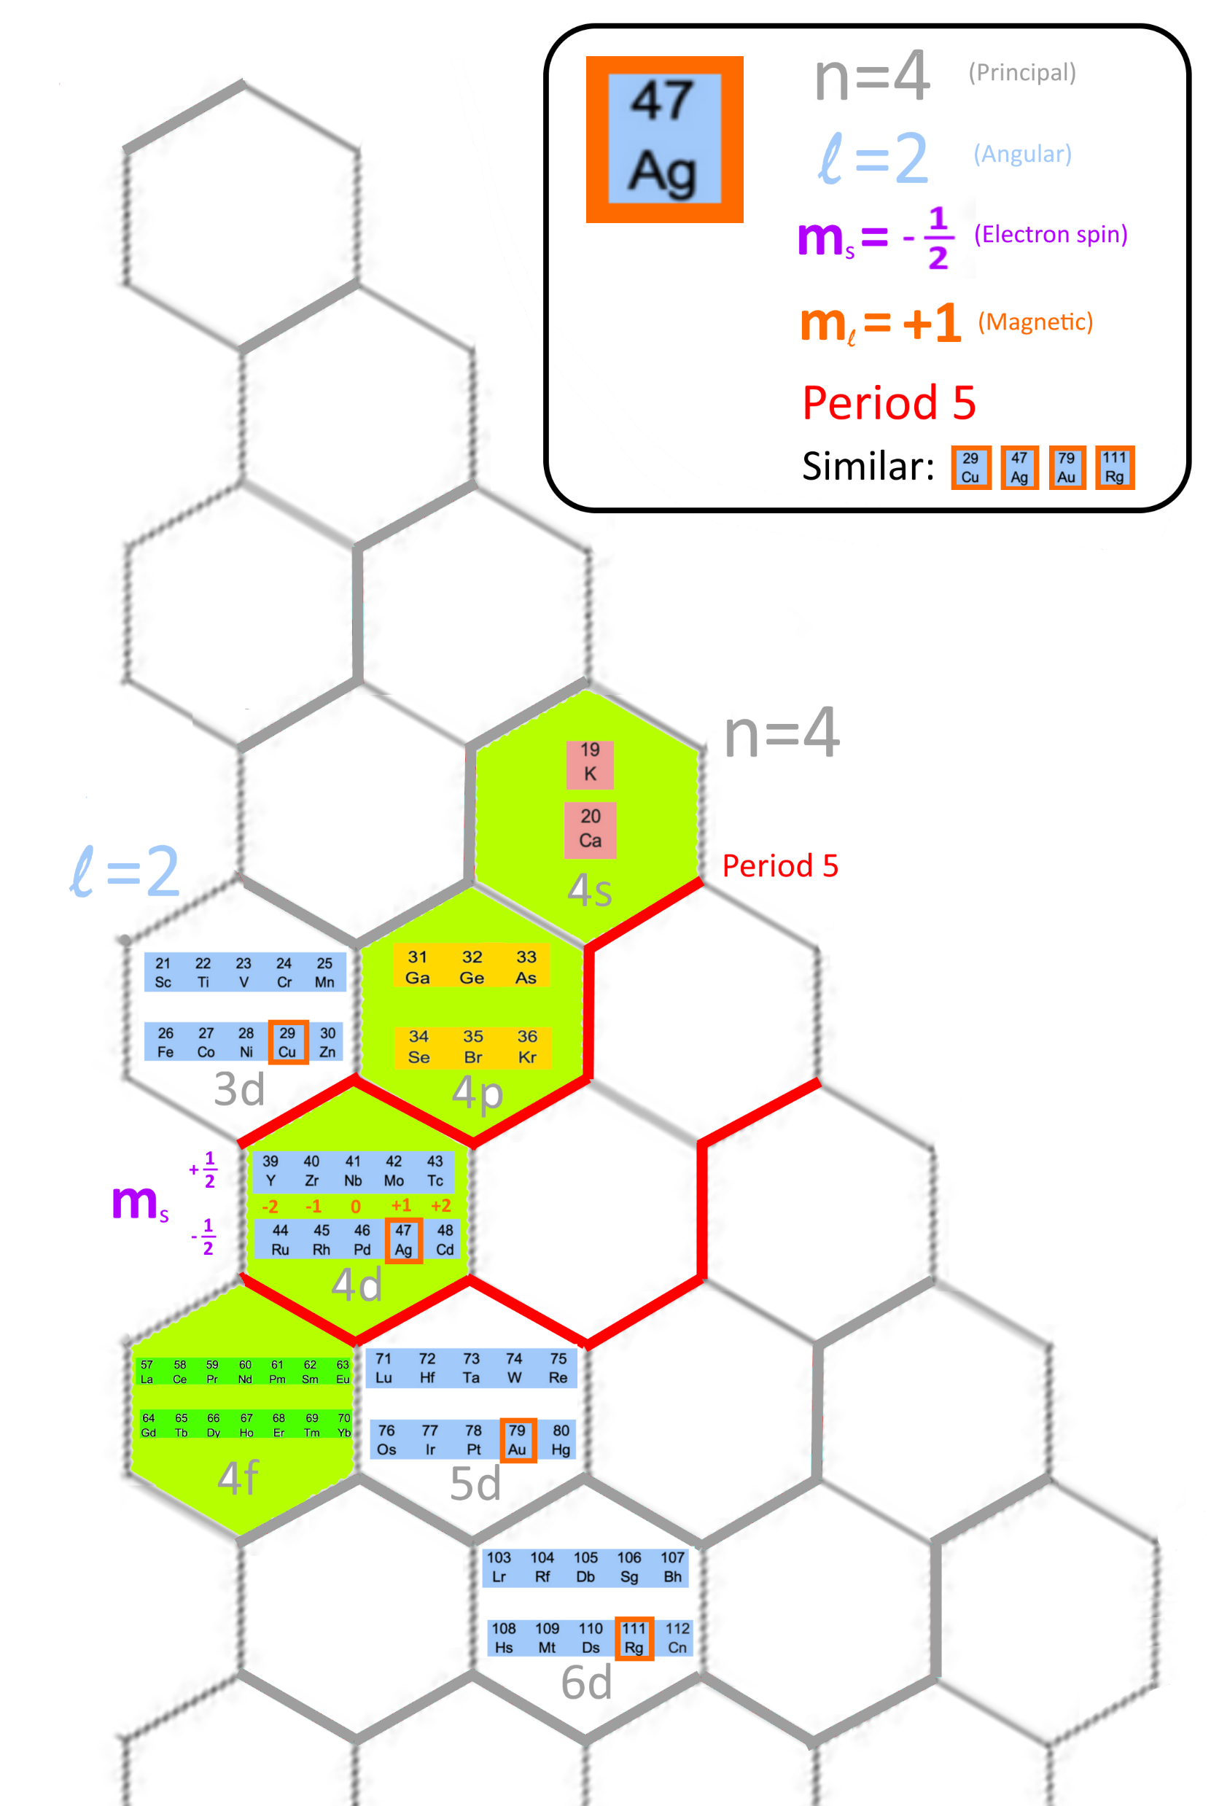
Pro: Coordinates can determine quantum numbers (QNs) easily
 | Determine using Existing table | Determine using New table
Principal QN: n | Less intuitive | Easy
Angular QN: l | Easy | Easy
Electron spin QN: m_{s} | Less intuitive | Easy
Magnetic QN: m_{l} | Difficult | Easy
Period | Easy | Easy
Similar elements | Easy | Easy

Slide 3
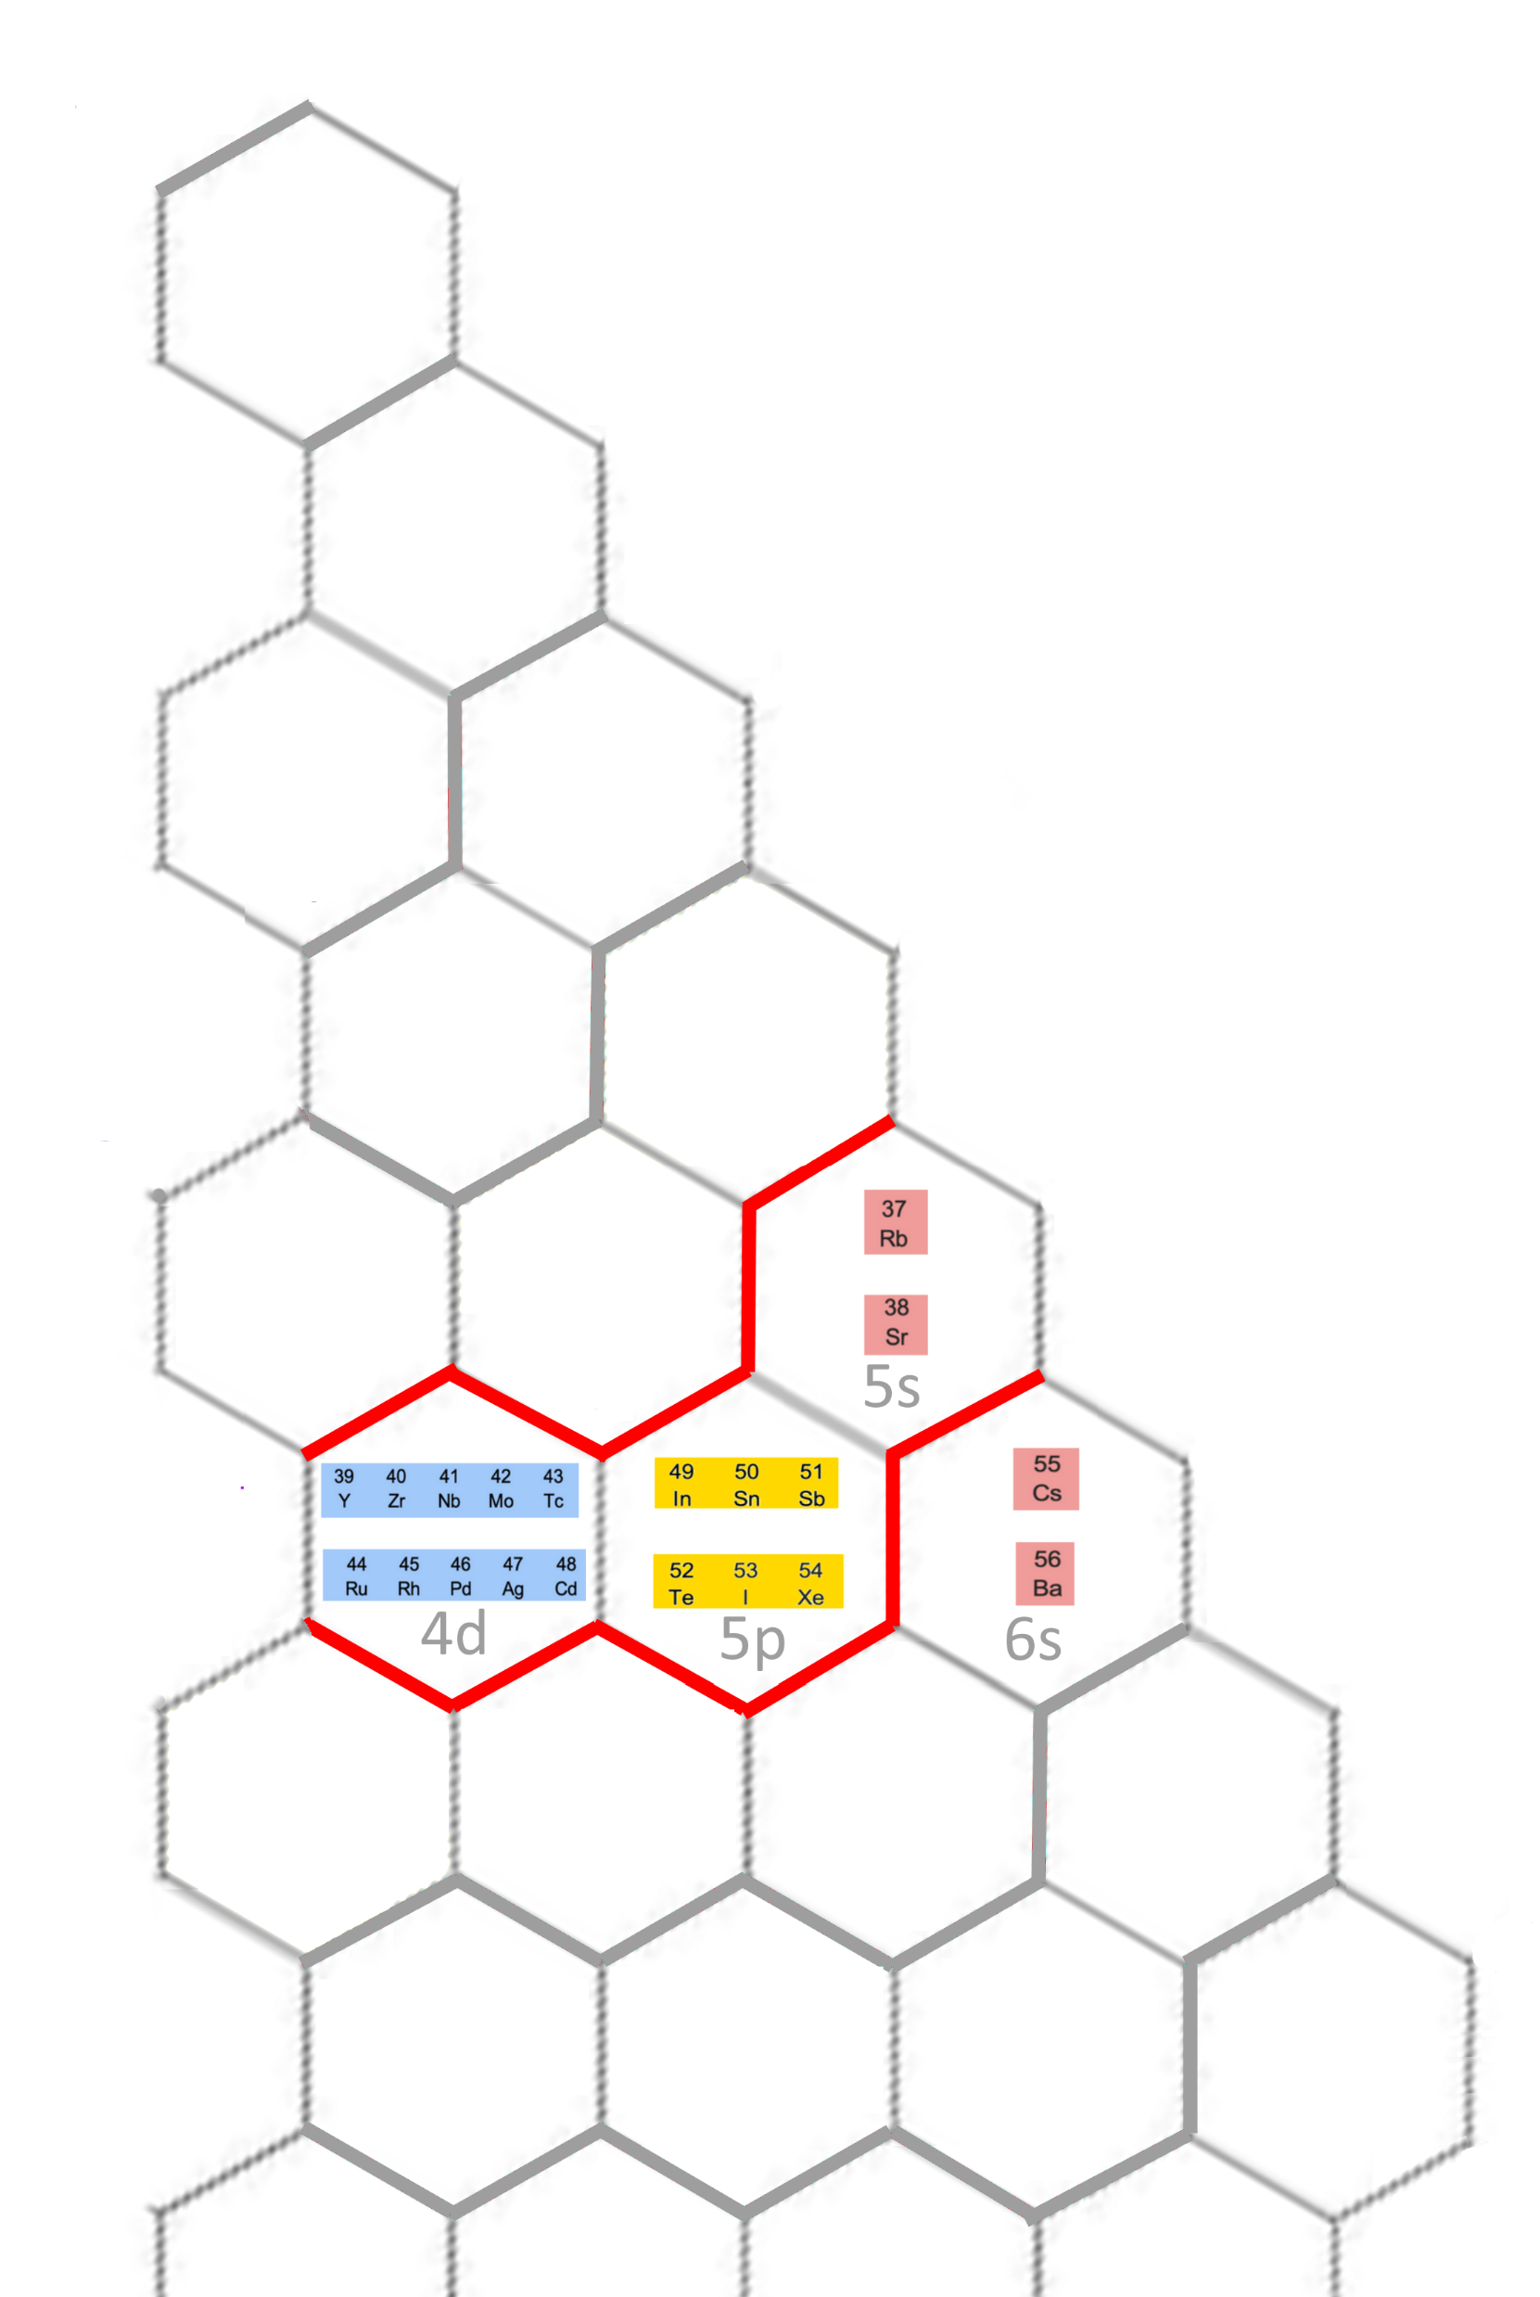
Pro: perform element number accounting easily
 | Reflected in Existing table | Reflected in New table
Electron filling order of elements e.g. Rb → Sr → Y → Zr … | Yes | Yes
Electron filling order of orbits e.g. 5s → 4d → 5p → 6s … | Yes, but less intuitive | Yes
Magnetic QN of orbits are 1, 3, 5, 7, … (i.e. 2l + 1) | Difficult to see | Yes
Number of elements of each period | Yes, but less intuitive | Yes e.g. Period 5: (1 + 3 + 5)*2

Slide 4
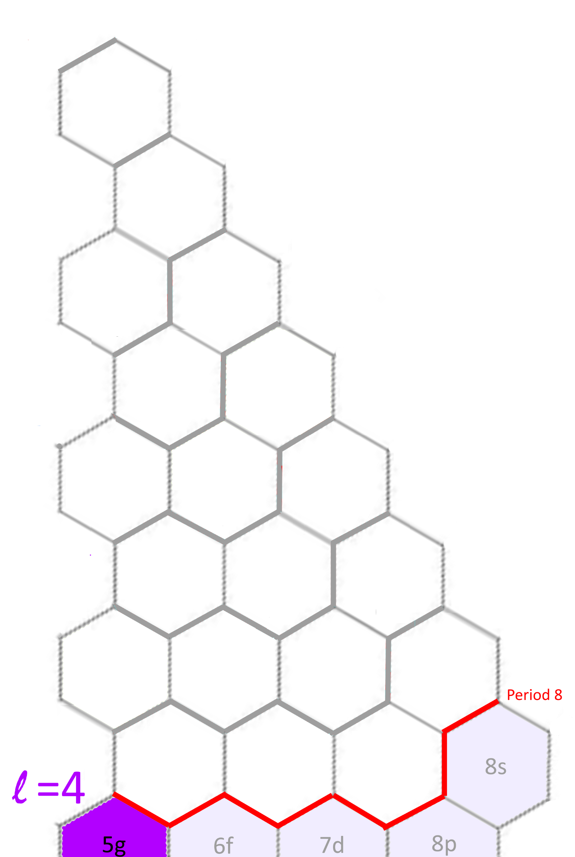
Pro: Can be extended easily
 | Existing table | New table
Extend to period 8 | Need to find new space for block g | Already have a place for block g

Slide 5
References
Other possible form of periodic table: https://en.wikipedia.org/wiki/Types_of_periodic_tables

